Slide 1
EC48W - Data Exploration Report
Ömer Mustafa Atagül, Ahmet Erdem Çetintaş, Zita Engels, Nida Nalbant, Ece Rende

Slide 2
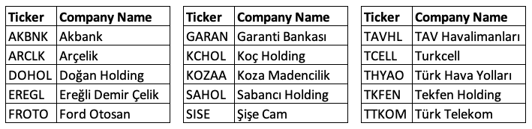
Data
Obtained from EC581 course
15 stocks from BIST30 stocks, dated from 01/01/2009 to 31/12/2018
Consists of OHLC (Open, High, Low, Close) prices and volume of each stock for each day

Slide 3
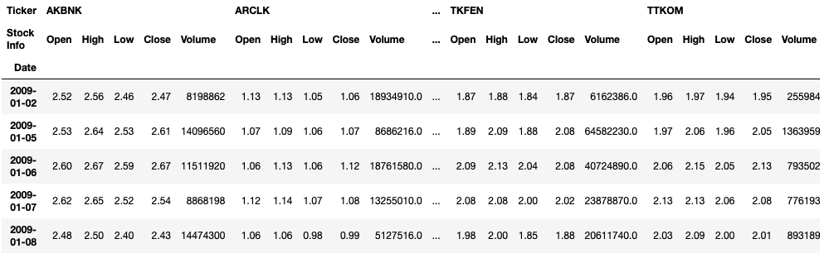
First 5 lines of first and last 2 stocks in the data

Slide 4
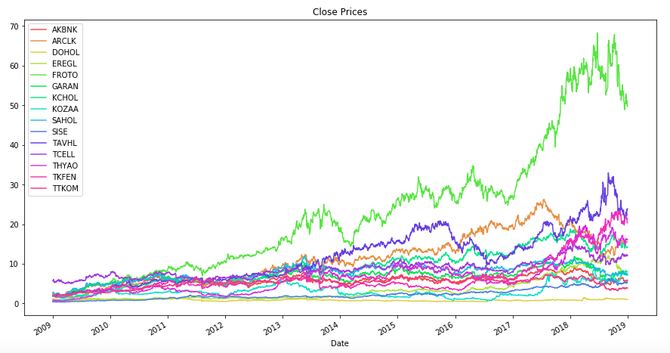
Close Prices
Upward trend with some fluctuations

Slide 5
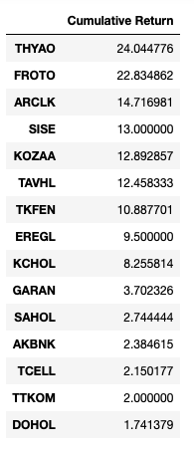
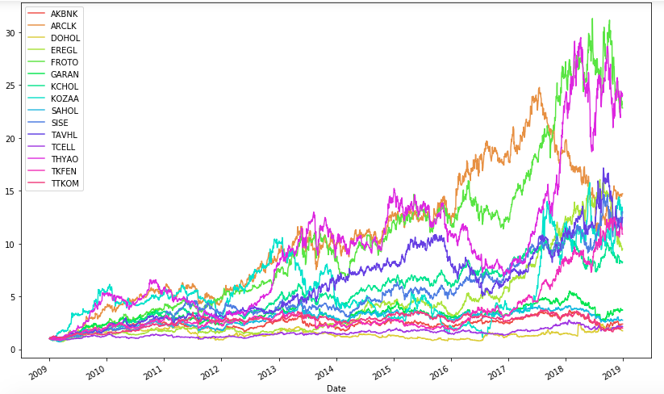
Initial close prices are set to 1 to see the cumulative return. If we bought THYAO on 01/01/2009 with 1000 TL, we would have 24045 TL at the end of 2018.

Slide 6
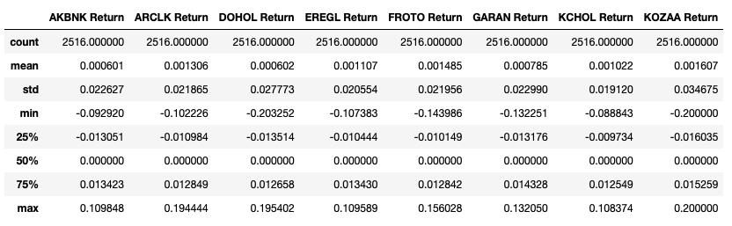
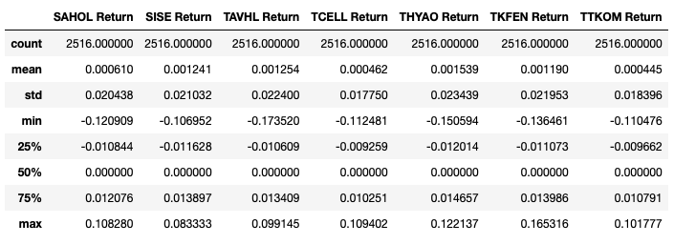
Daily Returns
Important statistics to discuss:
Maximum
Minimum
Standard deviation
of daily returns

Slide 7
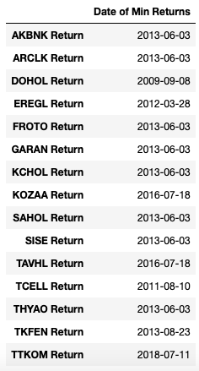
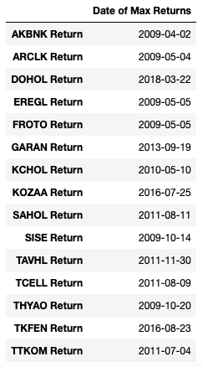
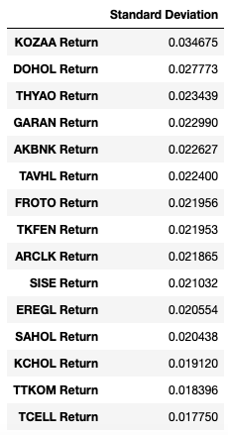
Biggest daily drops are on 03/06/2013, Gezi Parkı protests
No common dates for maximum daily returns
High standard deviation of returns can be a basic measure of high riskiness

Slide 8
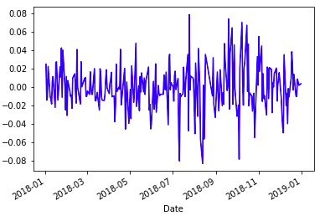
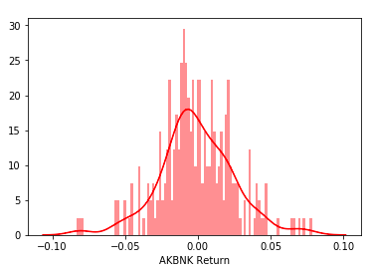
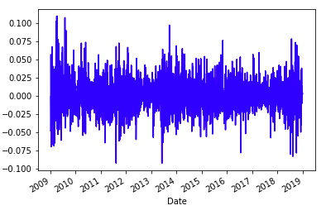
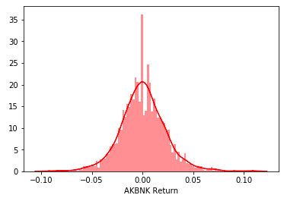
Since we have 15 stocks, we cannot put all the graphs of each stock here. So, a close look at the daily returns of AKBNK last year and through the whole period
It is seen that daily returns fluctuate rapidly around 0 through time
Likewise in histograms, gathering around 0 is observed

Slide 9
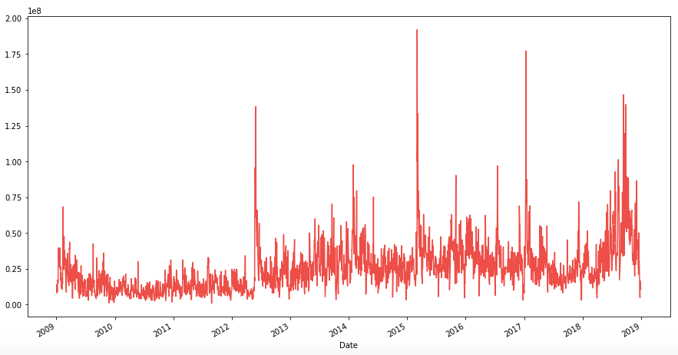
Volume
Daily volume graph of AKBNK

Slide 10
Machine Learning Method
Employ k-NN algorithm
Features are technical analysis indicators calculated from OHLC prices and volume data
Common technical analysis indicators
Moving Averages
Bollinger Bands
Stochastics
Relative Strength Index
Graphs of technical analysis indicators are in the following slides, but since we have 15 stocks, only AKBNK is shown as an example

Slide 11
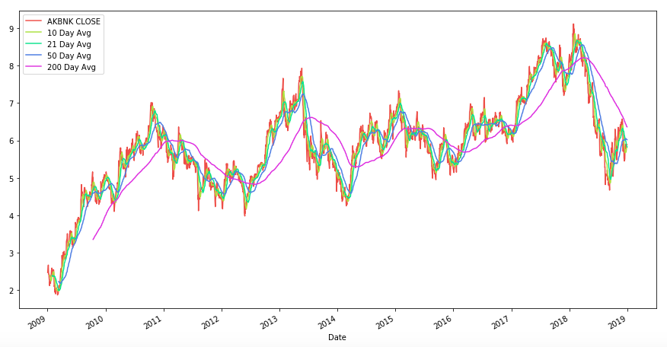
Simple Moving Averages of AKBNK

Slide 12
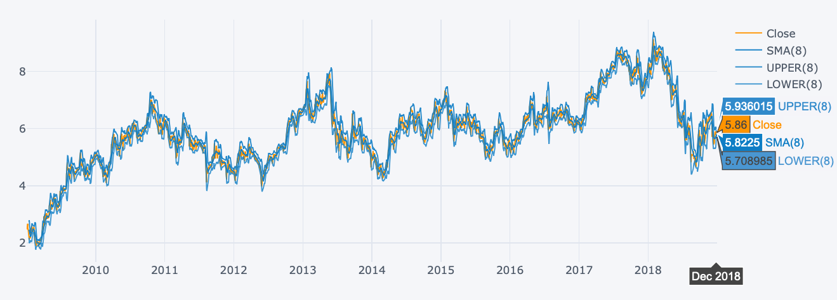
Bollinger Bands of AKBNK
With the commonly used parameters of (8,2)

Slide 13
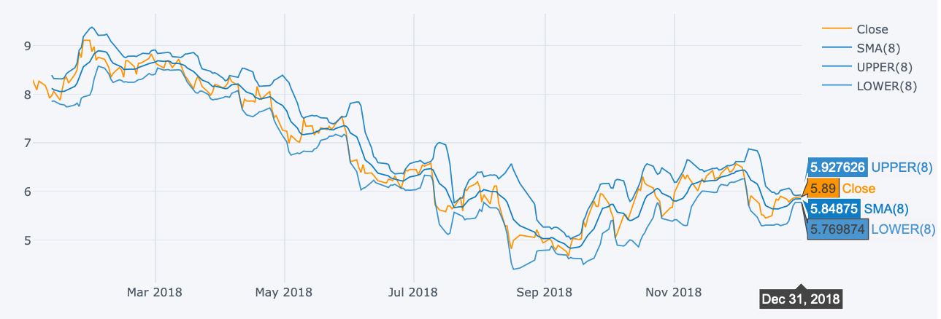
Bollinger Bands of AKBNK, last 1 year
With the commonly used parameters of (8,2)

Slide 14
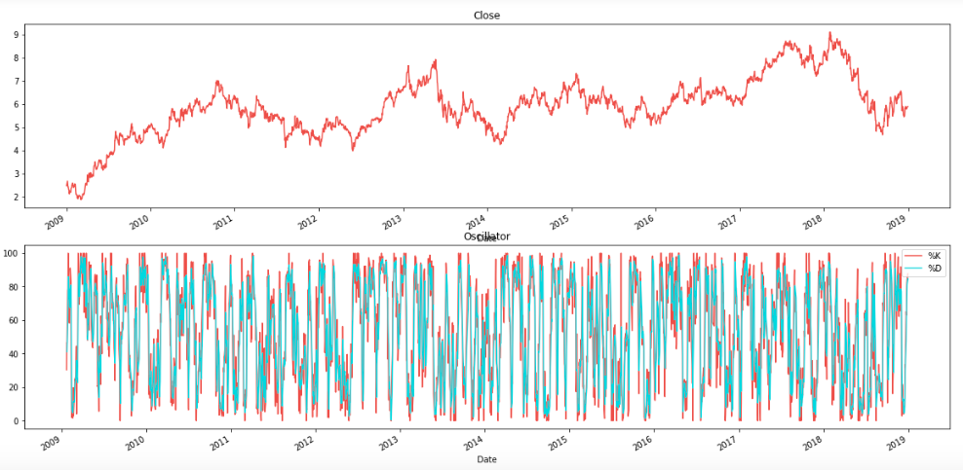
Stochastics of AKBNK, %K and %D lines
With the commonly used parameters of (14,3)

Slide 15
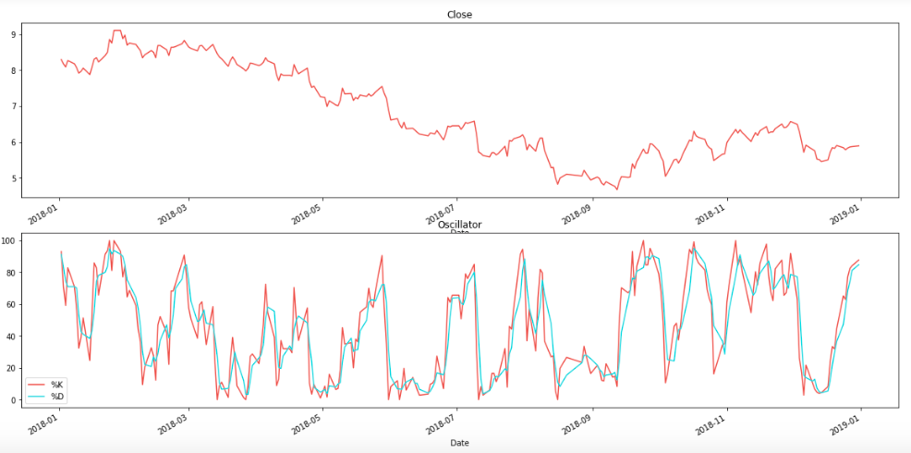
Stochastics of AKBNK, %K and %D lines, last 1 year
With the commonly used parameters of (14,3)

Slide 16
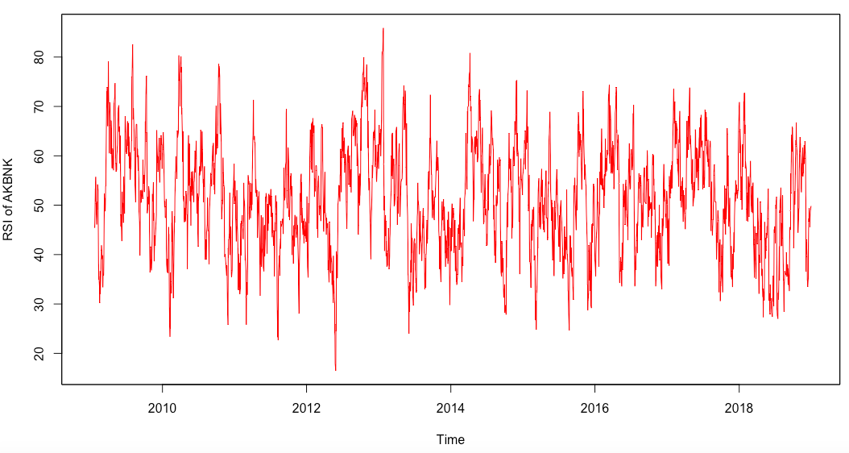
RSI of AKBNK
With the commonly used parameter of 14

Slide 17
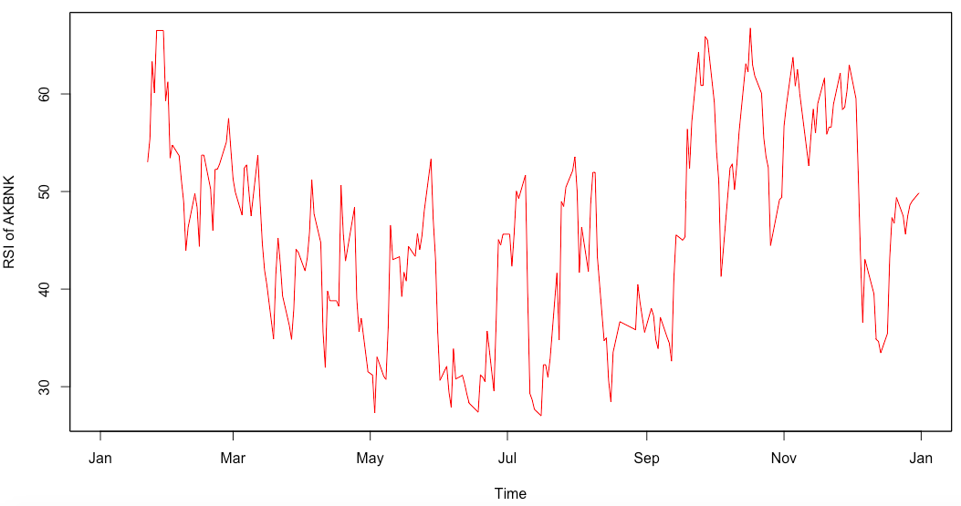
RSI of AKBNK, last 1 year
With the commonly used parameter of 14

